Slide 1


Data Lake & Warehouse
Understanding Modern Data Architectures

Slide 2

2
OVERVIEW OF DATA WAREHOUSE
1
What is a Data Warehouse?
Types of Data Warehouse Architecture
Data Mart: A Quick Review
Benefits and Challenges of Data Warehouse
OVERVIEW OF DATA LAKE
What is a Data Lake?
Data Lake Architecture
SWOT Analysis of Data Lake
3
KEY DIFFERENCES
AGENDA
Comparing Data Lake and Data Warehouse
ETL vs ELT
5
4
OVERVIEW OF DATA LAKEHOUSE
CONCLUSION
What is a Data Lakehouse?

Slide 3
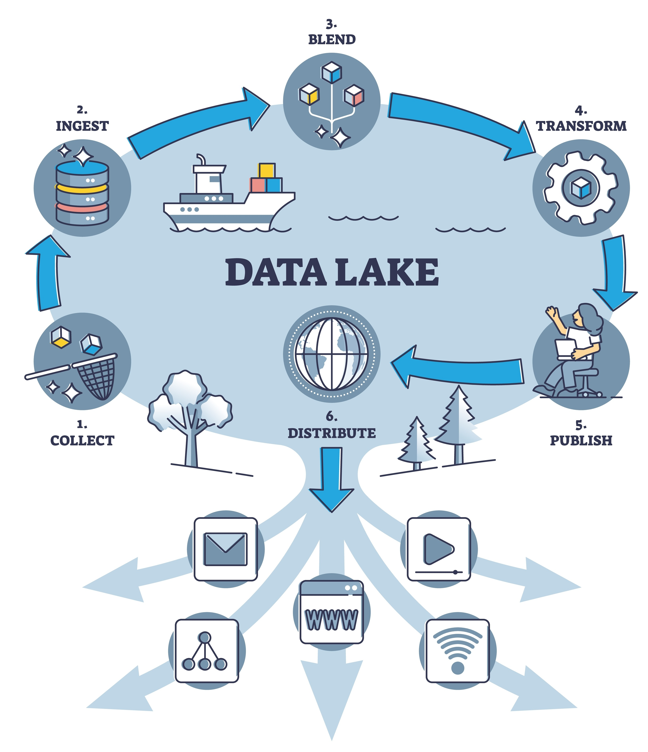
What is a Data Lake ?
A data lake is a centralized storehouse that enables organizations to store and manage enormous amounts of data in its native format— whether it’s structured, semi-structured, or unstructured—in a single, secure, managed environment that’s easily accessible across the enterprise.
TOP 7 DATA LAKE TOOLS:
Amazon S3 & AWS Lake Formation
Databricks Lakehouse (Delta Lake)
Microsoft Azure Data Lake Storage (ADLS)
Google Cloud Storage & BigLake
Snowflake Data Cloud
Apache Iceberg
Dremio Lakehouse Platform

Slide 4

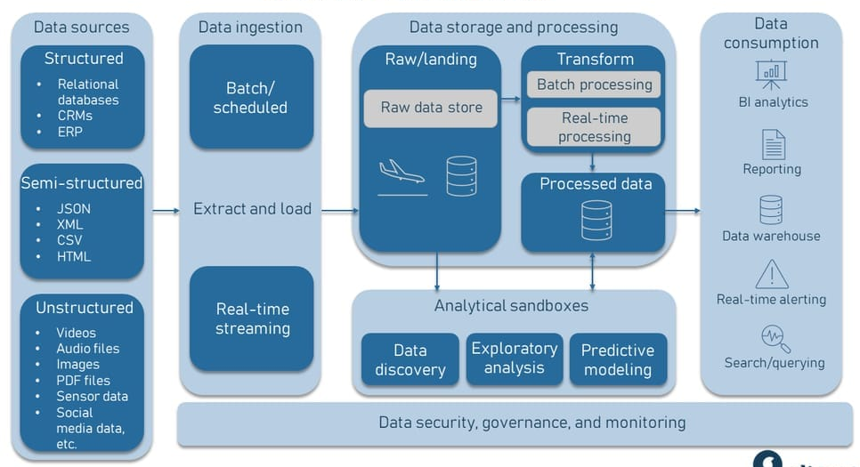
Data Lake Architecture

Slide 5
Governance
Security &
. Monitoring .
Data Lake Architecture
6.
Structured: Well-defined formats (e.g., SQL databases like MySQL, Oracle).
Semi-Structured: Partial structure (e.g., JSON, XML, HTML).
Unstructured: No fixed format (e.g., videos, IoT sensor data, social media).
1.
Data
Sources
2.
Data
Ingestion

Slide 6
Data
Sources
Data Lake Architecture
1.
Batch Ingestion: Scheduled, interval-based method of data importation. Tools often used for batch ingestion include Apache NiFi, Flume, and traditional ETL tools like Talend and Microsoft SSIS.
Real-Time Ingestion: Immediately brings data into the data lake as it is generated. Apache Kafka and AWS Kinesis are popular tools for handling real-time data ingestion.
2.
Data
Ingestion
3.
Data
Storage &
Processing

Slide 7
Data
Ingestion
Data Lake Architecture
2.
Raw Zone: Stores data in its native form. Utilizes storage solutions like Hadoop HDFS, Amazon S3.
Transformation section:
Data cleansing involves removing or correcting inaccurate records, inconsistencies in the data.
Data enrichment adds value to the original data.
Normalization modifies the data into a common format, ensuring consistency.
Structuring often involves breaking down data into a structured form suitable for analysis.
Processed data section: Additional transformation and structuring. Tools like Dremio or Presto may be used for querying this refined data.
Data
Storage &
Processing
3.
4.
Analytical
Sand-
boxes

Slide 8
Data
Storage &
Processing
Data Lake Architecture
3.
Data discovery: Explore the data to understand its structure & quality by statistics and data visualization.
Machine learning and predictive modelling: Involve a range of ML libraries like TensorFlow, PyTorch, or Scikit-learn to create predictive or classification models.
Exploratory data analysis (EDA): Statistical graphics, plots, and information tables are employed to analyze the data and understand the variables' relationships, patterns, or anomalies without making any assumptions.
Tools like Jupyter Notebooks, RStudio, or specialized software like Dataiku or Knime are often used within these sandboxes.
4.
Analytical
Sand-
boxes
5.
Data
Consump-
tion

Slide 9
Analytical
Sand-
boxes
Data Lake Architecture
4.
Final output layer of polished and reliable data.
Data is exposed via Business Intelligence tools like Tableau, Power BI.
Consumers are data analysts, decision makers, business teams and executives.
5.
Data
Consump-
tion
6.
Governance
Security &
Monitoring

Slide 10
Data
Consump-
tion
Data Lake Architecture
5.
Governance defines rules and policies for data access and quality. (e.g. Apache Atlas, Collibra)
Security protocols protects data from unauthorized access. (e.g. Varonis, McAfee Total Protection for Data Loss Prevention)
Monitoring handles the oversight and flow of data from its raw form into more usable formats. (e.g. Talend, Apache NiFi)
Stewardship involves active data management and oversight. (e.g. Alation, Waterline Data assist)
Governance
Security &
Monitoring
6.
1.
Data
Sources

Slide 11

SWOT Analysis of Data Lake
STRENGTHS
WEAKNESSES
Lower Costs: Uses open-source software and low-cost hardware, cutting both software and infrastructure expenses.
One-Stop Data Storage: Handles all data types—structured, semi-structured, unstructured—in one place, enabling better data integration and analysis.
Data Management: Governance and data handling are still maturing. Tools are improving but aren’t fully there yet.
Security: Historically weak, though improving. Many breaches still happen in traditional systems, not Hadoop-based ones.
OPPORTUNITIES
THREATS
Data Discovery: Enables users to uncover insights they didn’t know to look for—going beyond traditional reports and queries.
Advanced Analytics: Supports predictive, prescriptive, and diagnostic analytics—moving beyond simple visuals to deeper, smarter insights.
Resistance to Change: Transitioning from legacy systems is costly and disruptive, requiring cultural and operational shifts.
Skills Gap: Demand for expertise in big data tools is high, but talent is limited. However, this creates a chance to upskill and innovate.

Slide 12
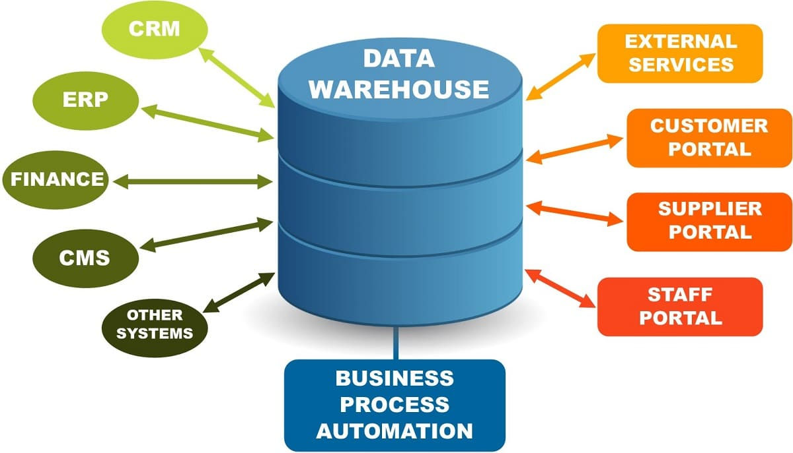
What is a Data Warehouse ?
A data warehouse is a centralized repository optimized for storing structured data from various sources, where the data is cleaned, transformed, and organized into a consistent format to support high-performance querying, reporting, and business intelligence—unlike a data lake, which stores raw data in its native format.
It help businesses quickly analyze big data and make smart decisions.
TOP 7 DATA WAREHOUSE TOOLS:
Snowflake
Azure Synapse Analytics
Google BigQuery
Amazon Redshift
IBM Db2 Warehouse
Oracle Autonomous Data Warehouse
Firebolt Cloud Data Warehouse

Slide 13

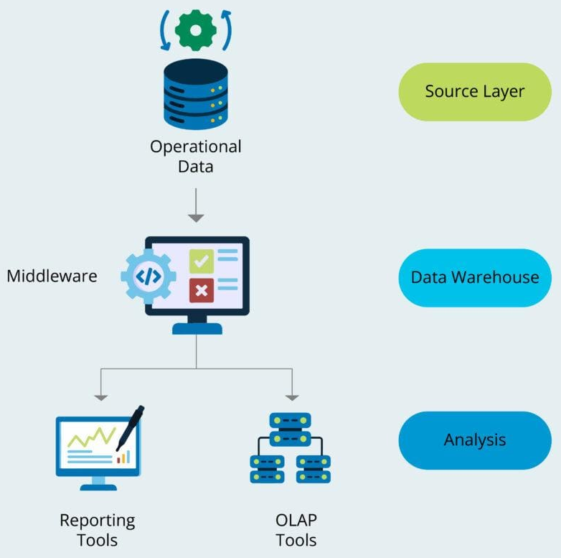
Types of Data Warehouse Architecture
Single-tier Data Warehouse Architecture
Designed for small-scale environments. Combines data storage and processing in a single layer.
Source Layer: Collects raw, real time data (operational data) from internal systems (Enterprise Resource Planning, Customer Relationship Management, spreadsheets etc.)
Data Warehouse: Stores, transforms, and processes data in one unified layer. ETL tasks (Extract, Transform, Load) are embedded here.
Analysis Layer: Performs both transactional and analytical processing on the same system. Can lead to performance bottlenecks due to shared resources.
Small businesses with limited data and basic reporting needs.

Slide 14
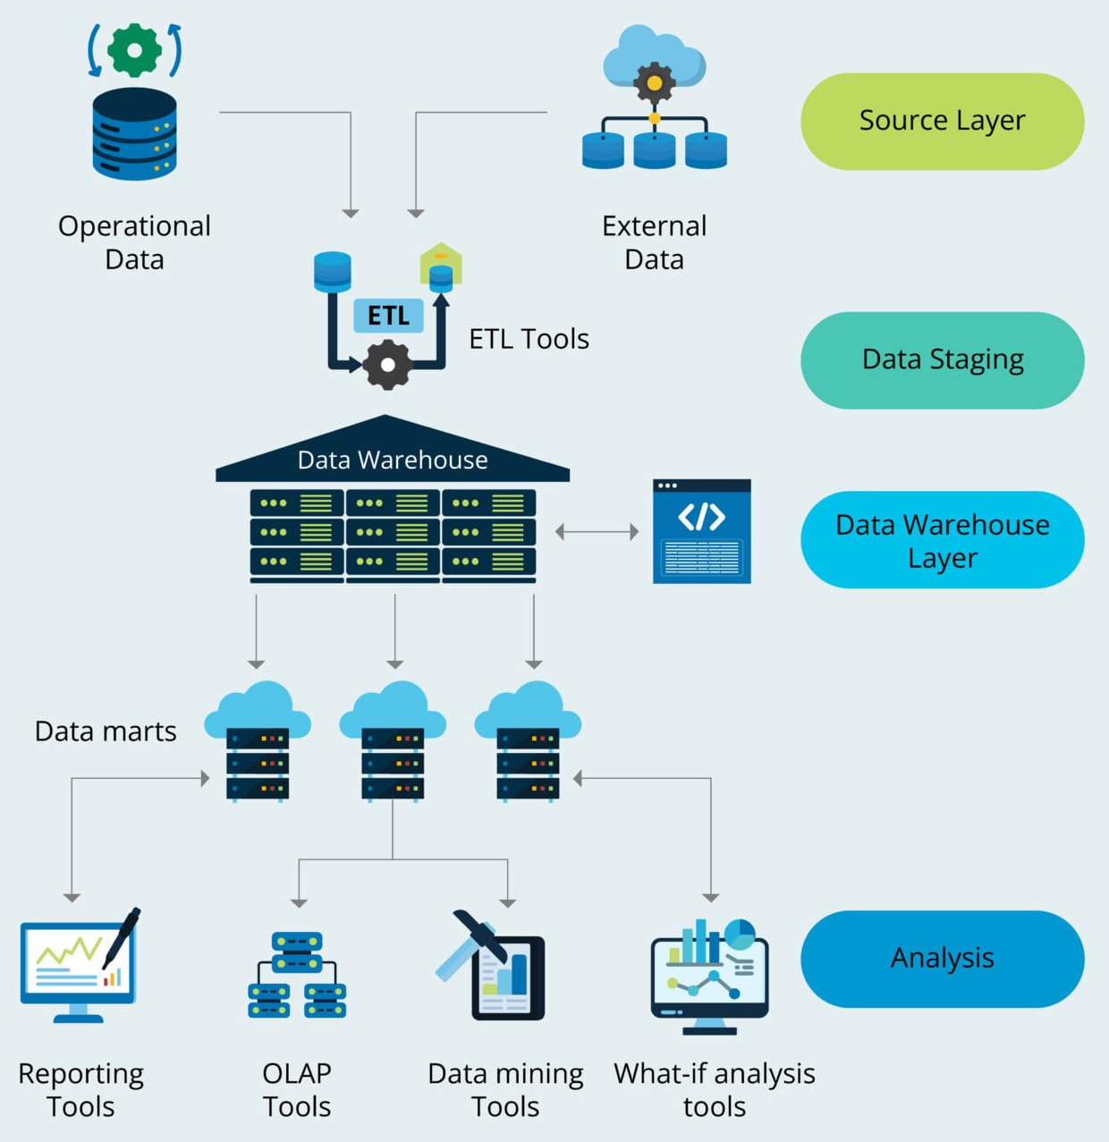
Types of Data Warehouse Architecture
Two-tier Data Warehouse Architecture
Adds a dedicated staging area and separates analytical from transactional systems. Offers improved performance over single-tier but with limited scalability.
Source Layer: Collects data from multiple sources — e.g., CRM, ERP, flat files, spreadsheets.
Staging Layer: Temporary holding area for data. Performs ETL operations like cleaning, deduplication, formatting.
Warehouse Layer: Stores transformed, structured data. Organized into schemas optimized for querying.
Analysis Layer: Provides user access through BI tools and reporting interfaces. Supports dashboards, ad-hoc queries, and summary reports.
Medium-sized businesses requiring clean data and moderate reporting needs.

Slide 15

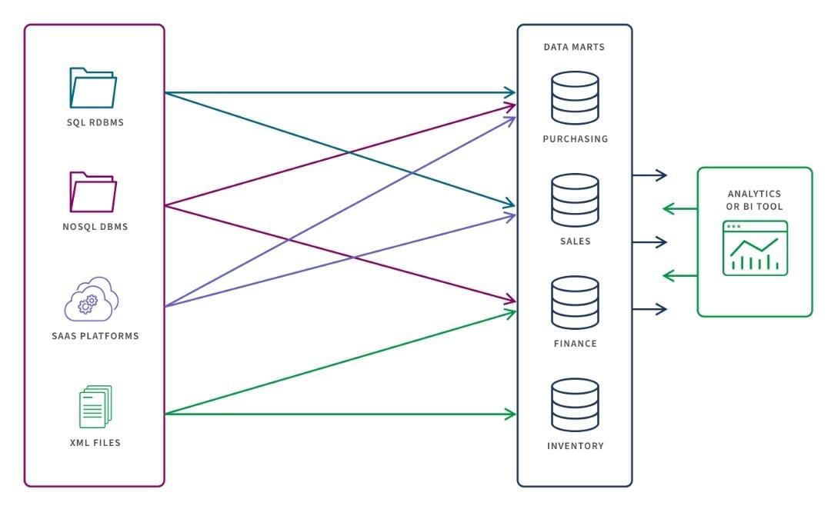
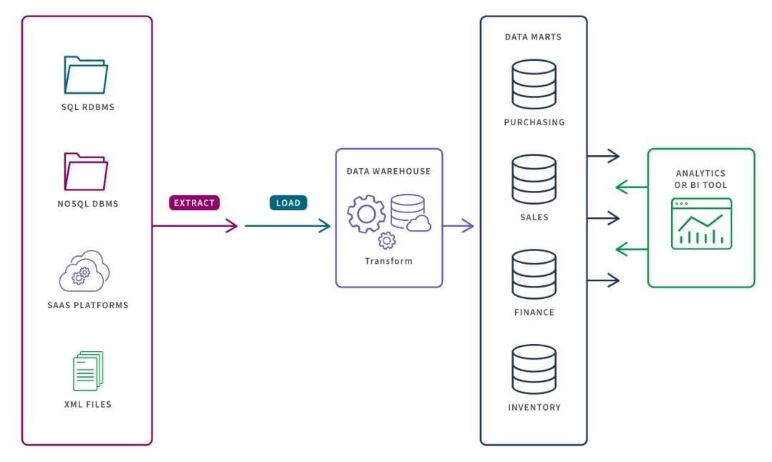
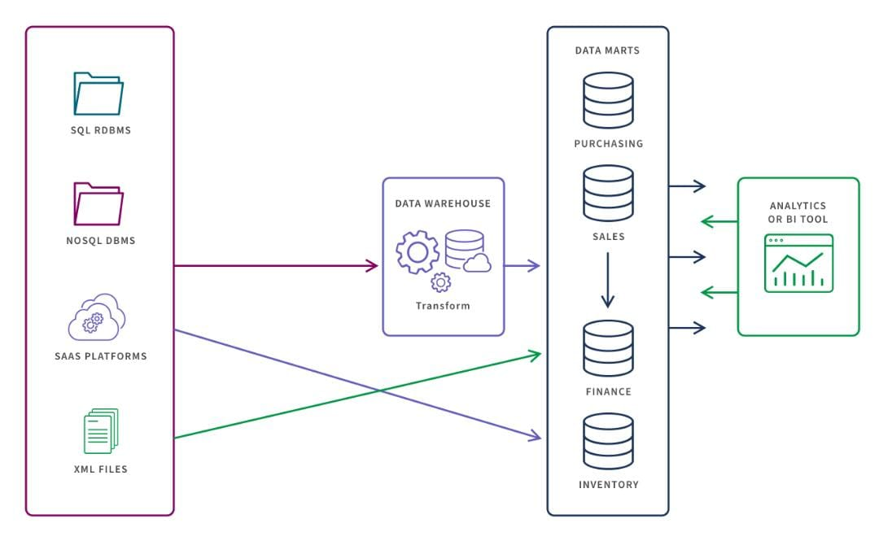
Data Mart: A Quick Review
A data mart is a specialized subset of a data warehouse focused on a specific functional area or department within an organization. It provides a simplified and targeted view of data, addressing specific reporting and analytical needs.
Independent Data Mart
Built separately for a specific department without relying on a central warehouse.
Dependent Data Mart
Created from a central data warehouse to ensure consistent and integrated data.
Hybrid Data Mart
Combines warehouse data with local sources to balance consistency and flexibility.

Slide 16
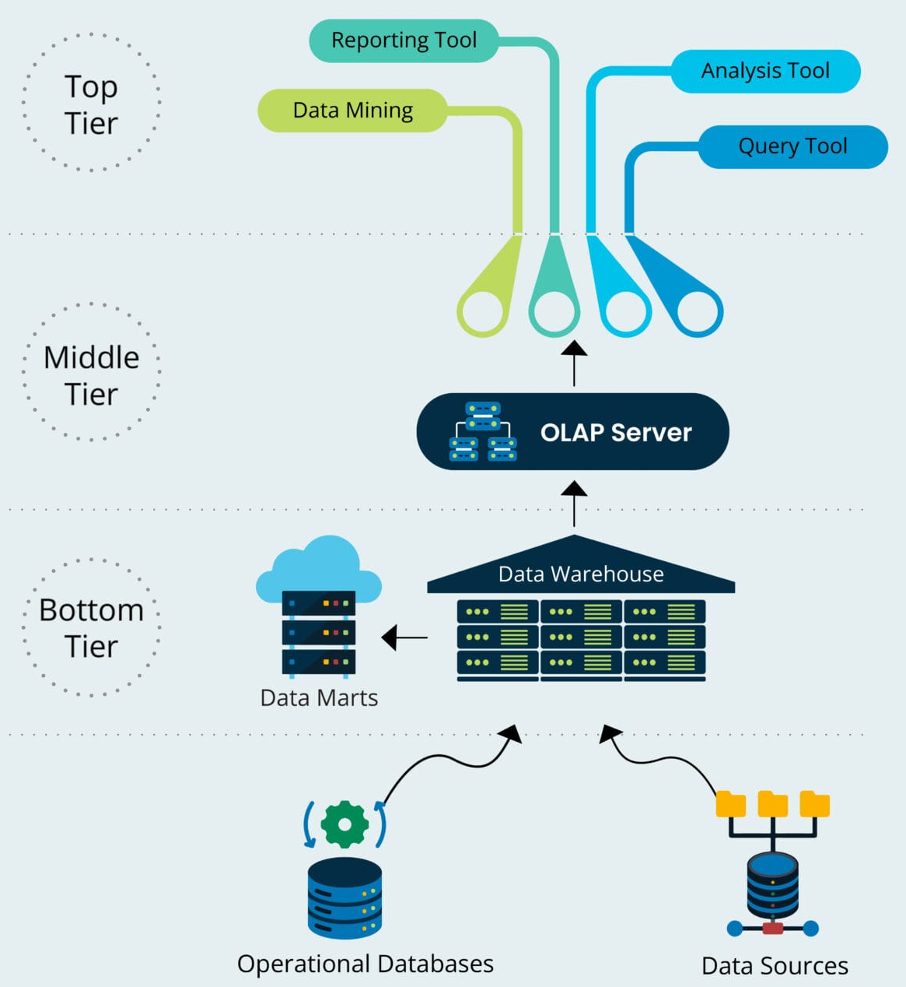
Types of Data Warehouse Architecture
Three-tier Data Warehouse Architecture
Most widely adopted. Separates storage, processing, and user interaction layers.
Bottom Tier (Data Warehouse Layer): Stores large volumes of cleansed, transformed data. Ensures consistency and quality.
Middle Tier (OLAP / Reconciled Layer): Uses OLAP servers to organize data into a user-friendly format. Enables multidimensional analysis and fast querying.
Top Tier (Presentation Layer): User access layer with dashboards, reports, BI tools. Provides business insights and visualizations.
Large enterprises with high data volumes and complex analytics needs.

Slide 17
Benefits & Challenges of Data Warehousing
Benefits
Challenges
Improved data quality: Data is cleaned, transformed, and organized, ensuring high accuracy and consistency.
Competitive advantage: Enables strategic insights by uncovering hidden customer and market trends.
Productivity of decision makers: Enhances decision-making efficiency through consistent and integrated historical data.
Cost-effective decision making: Reduces IT dependency and external data needs by centralizing data storage.
Faster data access: High-speed servers and structured storage allow rapid querying and retrieval of data.
Underestimation of data loading resources: Data cleaning and loading often take more time than anticipated.
Hidden problems in source systems: Data quality issues in source systems may surface only after integration.
Data homogenization: Standardizing data formats can lead to the loss of nuanced or valuable data.
Complex setup and training: Needs expert professionals and thorough staff training to avoid mismanagement or data loss.
Real-time delays: Real-time data must be processed before storage, causing delays in availability.

Slide 18
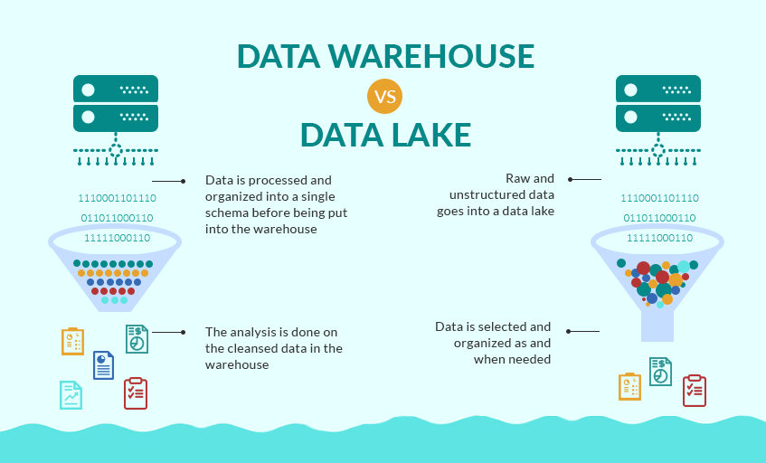
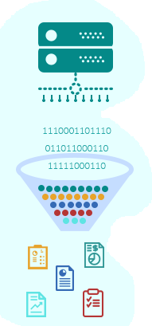
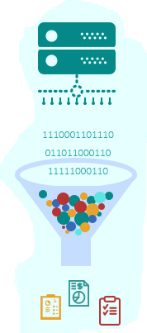
Comparing Data Warehouse and Data Lake
Data Warehouse | vs | Data Lake
structured, processed | DATA | structured/semi-structured /unstructured, raw
schema-on-write | PROCESSING | schema-on-read
expensive for large data volumes | STORAGE | designed for low-cost storage
less agile, fixed configuration | AGILITY | highly agile, configure and reconfigure as needed
mature | SECURITY | maturing
business professionals | USERS | data scientists et. al.

Slide 19
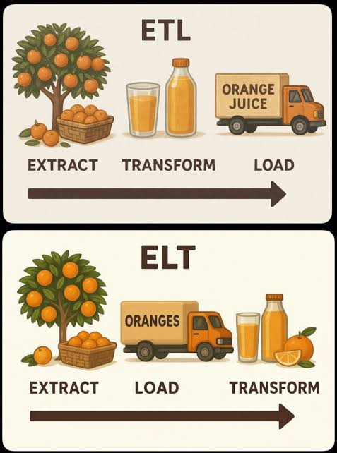
ETL vs ELT
Category | ETL | ELT
Purpose | ETL extracts data, transforms it using a secondary processor, and loads it. | ELT extracts data, loads it, and transforms it within the system.
Expense | Using multiple servers is expensive. | The simplified process cuts costs.
Speed | Transferring transformed data takes a lot of time. | ELT is faster because the data is loaded and transformed in the same system.
Maturity | ETL has been around for over 20 years. | ELT is a new integration method.
Privacy | The pre-loaded transformation helps you meet government regulations. | Loading raw data directly requires extra protection.
Maintenance | Managing a second processor is a hassle. | The fewer systems make maintenance easier.

Slide 20

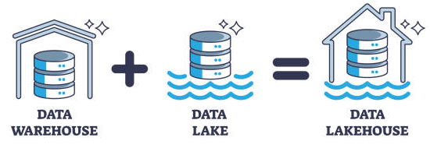
What is a Data Lakehouse ?
A Data Lakehouse is a modern data architecture that combines the best features of a data warehouse and a data lake.
It offers the scalability and flexibility of a data lake for storing all types of data, with the reliability and performance of a data warehouse for analytics.

Slide 21
Conclusion
The future of data management is hybrid and unified
Data Warehouses are best for structured data and traditional BI reporting.
Data Lakes are great for storing large, raw, and diverse data types.
Data Lakehouses combine the strengths of both — flexible, scalable, and analytics-ready.
A strategic blend of data lake, warehouse, and lakehouse can drive smarter decisions and long-term innovation.

Slide 22
Thank you

